Slide 1
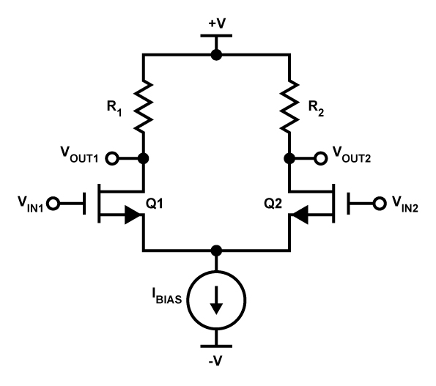
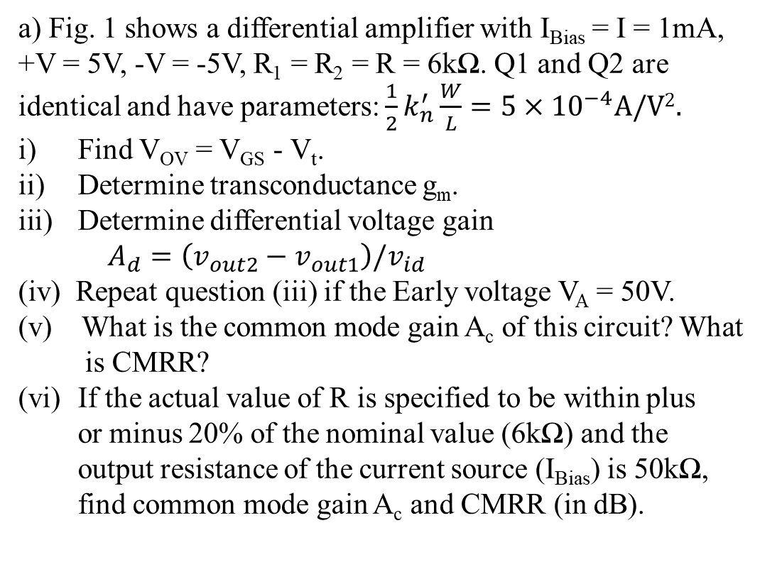
Quiz 3.3
a) Fig. 1 shows a differential amplifier with I_{Bias} = I = 1mA, +V = 5V, -V = -5V, R₁ = R₂ = R = 6kΩ. Q1 and Q2 are identical and have parameters: $\frac{1}{2}k_{n}^{′}\frac{W}{L}=5×{10}^{−4}A/V2.$
Find V_{OV} = V_{GS} - V_{t}.
Determine transconductance g_{m}.
Determine differential voltage gain
$A_{d}=\left(v_{out2}−v_{out1}\right)/v_{id}$
(iv) Repeat question (iii) if the Early voltage V_{A} = 50V.
(v) What is the common mode gain A_{c} of this circuit? What
is CMRR?
If the actual value of R is specified to be within plus
or minus 20% of the nominal value (6kΩ) and the
output resistance of the current source (I_{Bias}) is 50kΩ,
find common mode gain A_{c} and CMRR (in dB).
v_{id}/2
-v_{id}/2
Fig. 1

Slide 2
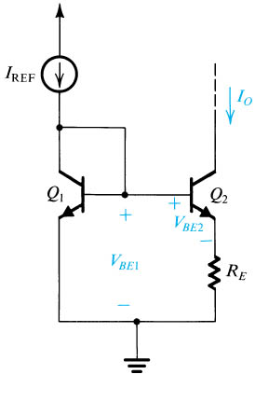
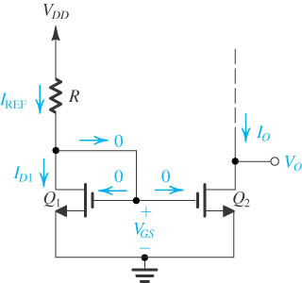
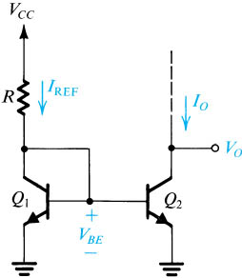
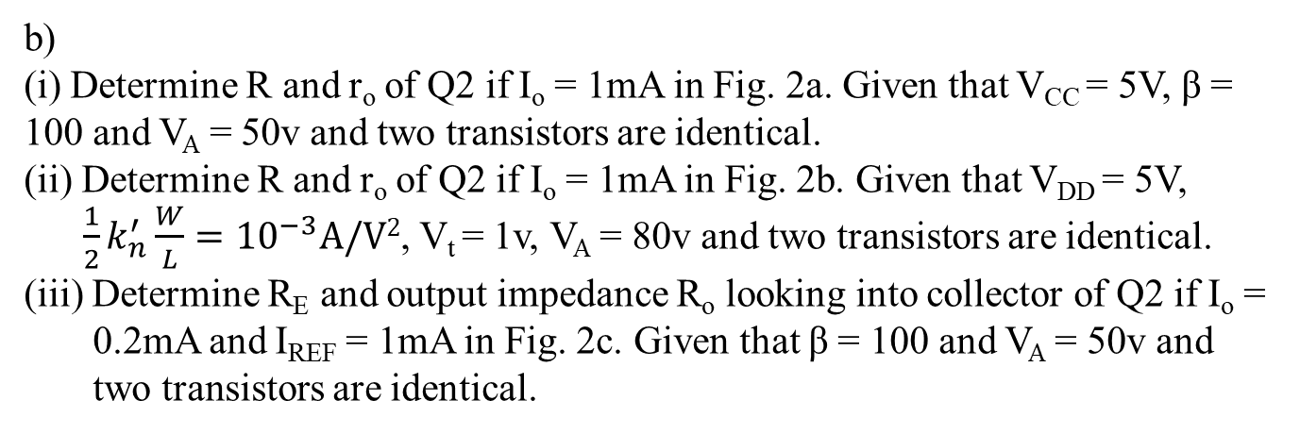
Fig. 2a
V_{CC}
Fig. 2c
Fig. 2b
b)
(i) Determine R and r_{o} of Q2 if I_{o} = 1mA in Fig. 2a. Given that V_{CC} = 5V, β = 100 and V_{A} = 50v and two transistors are identical.
(ii) Determine R and r_{o} of Q2 if I_{o} = 1mA in Fig. 2b. Given that V_{DD} = 5V,
$\frac{1}{2}k_{n}^{′}\frac{W}{L}={10}^{−3}A/V2$, V_{t} = 1v, V_{A} = 80v and two transistors are identical.
(iii) Determine R_{E} and output impedance R_{o} looking into collector of Q2 if I_{o} =
0.2mA and I_{REF} = 1mA in Fig. 2c. Given that β = 100 and V_{A} = 50v and
two transistors are identical.
You submit your solution not later than April 3, 2020.

